Slide 1
My Portfolio
STUDENT NAME: AARATHI.S
REGISTER NO :24BSAI202
NMID: 1CDE75104A06F5B81ED4CB339327A939
DEPARTMENT: B.SC ARTIFICIAL INTELLIGENCE AND MACHINE
LEARNING
COLLEGE: SRI KRISHNA ADITHYA COLLEGE OF ARTS AND SCIENCE UNIVERSITY:BHARATHIYAR UNIVERSITY

Slide 2
PROJECT TITLE MY PORTFOLIO

Slide 3


AGENDA
Problem Statement
Project Overview
End Users
Tools and Technologies
Portfolio design and Layout
Features and Functionality
Results and Screenshots
Conclusion
Github Link
3/21/2024 Annual Review

Slide 4

1.PROBLEM STATEMENT
To design and develop a personal portfolio website that showcases my profile, skills, and projects.
The portfolio acts as an online resume and project showcase for academic and professional growth.

Slide 5

2.PROJECT OVERVIEW
A single-page responsive website built with HTML, CSS, and JavaScript.
Sections include:
Introduction (Hello + About Me)
Profile Photo & Personal Info
Projects Showcase
Contact Form
Footer with copyright.

Slide 6

3.WHO ARE THE END USERS?
Students – For creating academic/project portfolios.
Recruiters/Employers – To review candidate profile & projects quickly.
Faculty/Guides – To evaluate student’s technical skills and project work.
Self – As a digital resume for internships & job opportunities.

Slide 7

4.TOOLS AND TECHNIQUES
Frontend Languages:
HTML – Structure of the webpage
CSS – Styling and layout
JavaScript – Interactivity (form submission, smooth scroll, etc.)
CodePen – Development and live preview
Image Hosting: i.ibb.co

Slide 8
5.POTFOLIO DESIGN AND LAYOUT
Header Section – Title, Hello message, "View My Work" button
About Me Section – Profile picture + short intro (AI & ML student)
Projects Section – 3 horizontal project cards
Contact Section – Contact form with Name, Email, Phone, Send button
Footer – Copyright
8

Slide 9
6.FEATURES AND FUNCTIONALITY
Responsive design – Works on desktop & mobile
"View My Work" button links to Projects section
Contact form with input fields (Name, Email, Phone)
Footer auto-updates with current year using JavaScript
Simple, modern, and user-friendly layout

Slide 10
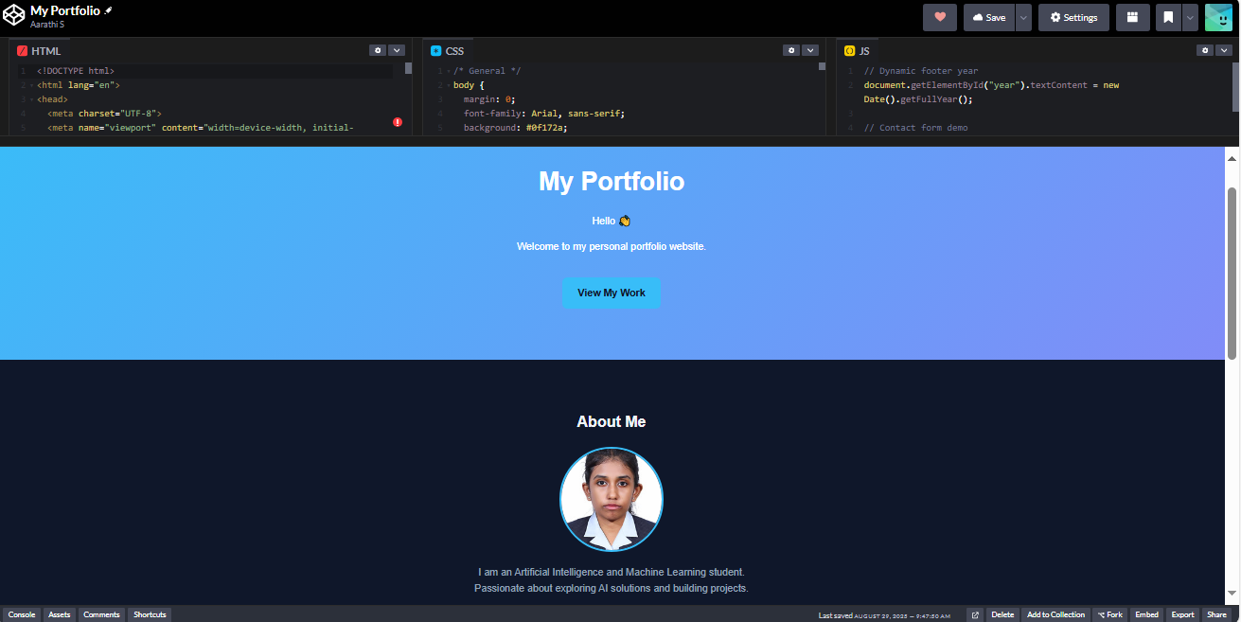

7.RESULTS AND SCREENSHOTS
3/21/2024 Annual Review
10

Slide 11
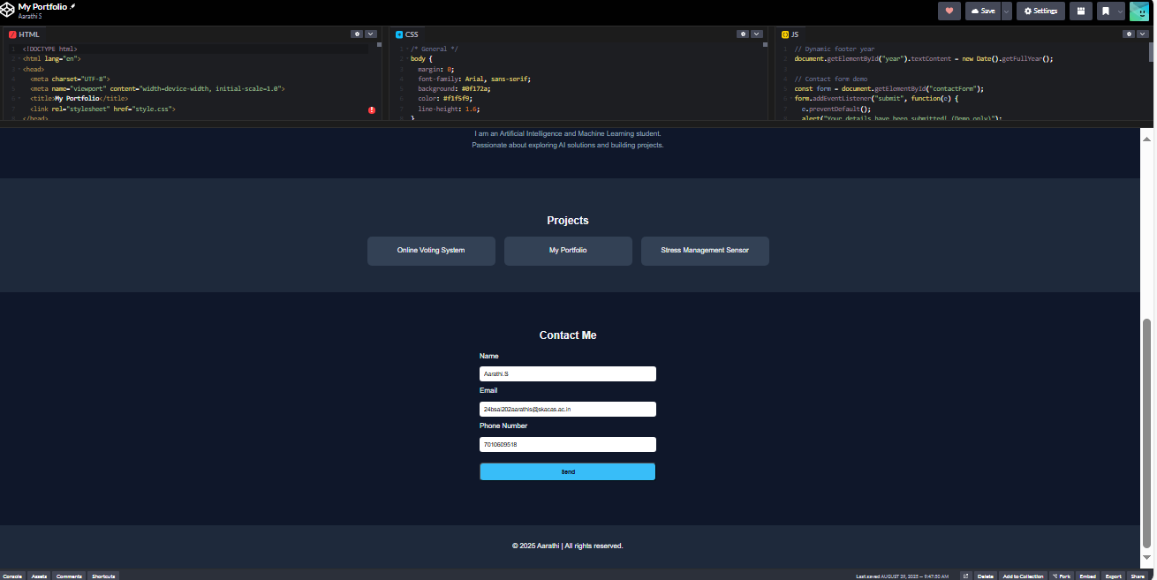

Slide 12
8.CONCLUSION
Successfully built a personal portfolio website using HTML, CSS, and JavaScript.
Provides a professional online presence.
Can be enhanced with:
Dark/Light mode
More projects
Integration with backend/email service for real form submission
12

Slide 13
9.GITHUB LINK
https://github.com/24bsai202aarathis-blip

